Slide 1

Sentimental Analysis for Alexa from amazon-
https://alexa-sentiment-analysis.herokuapp.com/
P58-Group-07
Names of Team Members :
Parth
Neha
Aniket
Jayesh
Seema
Name of Mentor
Munmun

Slide 2
Business Problem:
Predict feasibility for continuing sale of Amazon Alexa based on sentiment Analysis of Reviews of Users
Objective:
The objective of the analysis is to predict whether to continue selling product or not based on sentiment analysis of review and rating based analysis, also to predict future inputs reviews sentiments into positive or negative.

Slide 3
Types of Analysis to be performed for results :
Rating Based Analysis
Sentiment analysis for reviews
Tableau charts for visualization

Slide 4
Project Architecture / Project Flow
Collection of reviews from amazon for product Amazon Alexa.
Categorical separation of data collected using excel into 0 and 1.
Loading data set and descriptive analysis.
Checking for null values and treating if any.
Rating based analysis based on rating from user in range of 1-5.
Tableau dynamic charts for rating based analysis.
EDA and descriptive analysis for reviews categorized into 0 and 1.
Preprocessing like- Tokenization, stop words removal, punctuation removal, Lemmatization.
Word cloud generation.
Splitting data into test train sets.
Dataset balancing for train dataset.
Building model.
Check accuracy for train data using the model.
Check accuracy for test data using the model.
Check accuracy for test data using the model.
Model selection on accuracy.
Flask based deployment of model.
Making Html Templates for input and output.
Finally deployment of model on Heroku.

Slide 5
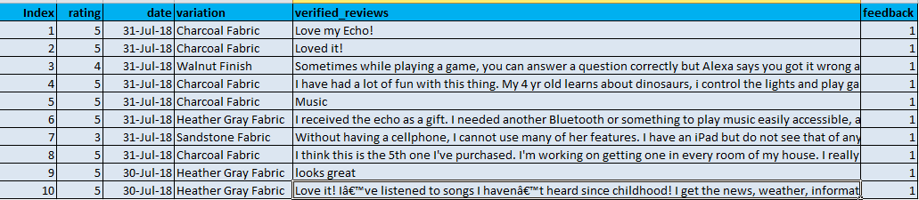
Data set details
Name of Dataset : Amazon_alexa.csv
No. of Rows : 3150
No. of columns : 5
Date ranges : 16-May-18 TO 31-Jul-18
Missing values : 0
Dataset

Slide 6
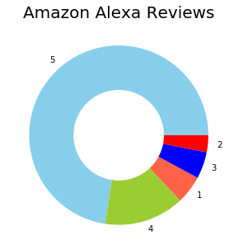
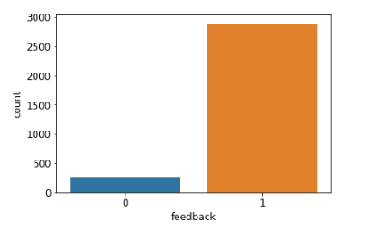
Exploratory Data Analysis (EDA)
Maximum number of reviews are Positive.
Total Number of Positive feedback : 2893 out of 3150 (91.84%)
Total number of negative feedback : 257 out of 3150 (8.16%)

Slide 7

WordCloud
WordCloud Generated for Dataset

Slide 8
Model results
Model – Naive Bayes
Train data Results
Accuracy : 94.73%
Recall : 90.83%
Precision : 98.50%
F1 Score : 94.51
Test data Results
Accuracy : 88.15%
Recall : 90.62%
Precision : 96.19%
F1 Score : 93.33
Overall data Results
Accuracy : 90.13%
Recall : 90.77%
Precision : 98.35%
F1 Score : 94.41

Slide 9
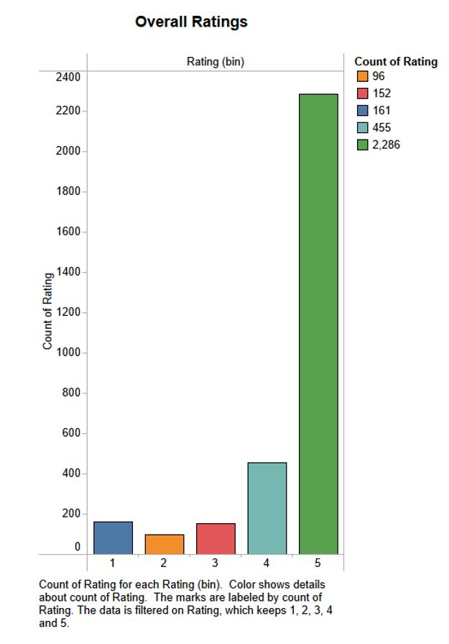
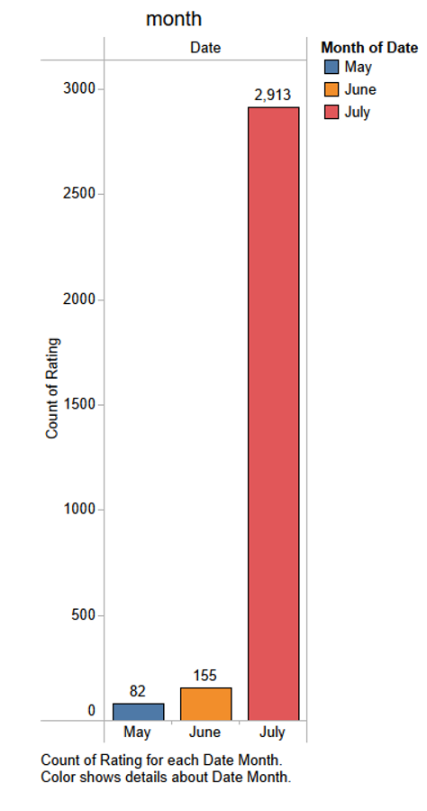
Visualization-using Tableau 1) Overall Rating or Rating bins versus count of rating 2)Month-wise count of rating or month versus count of rating
1 star-161 reviews,2 star-96 reviews, 3star=152 reviews,4-star=455 reviews, 5 star=2286 reviews.
2) we can figure out here that we have received the least reviews- May, while highest sale happened in the month of July.

Slide 10
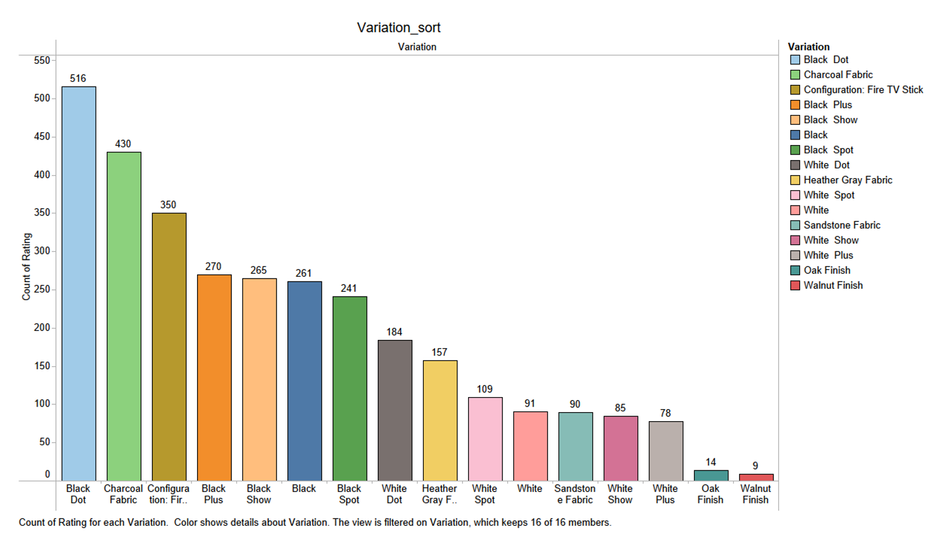
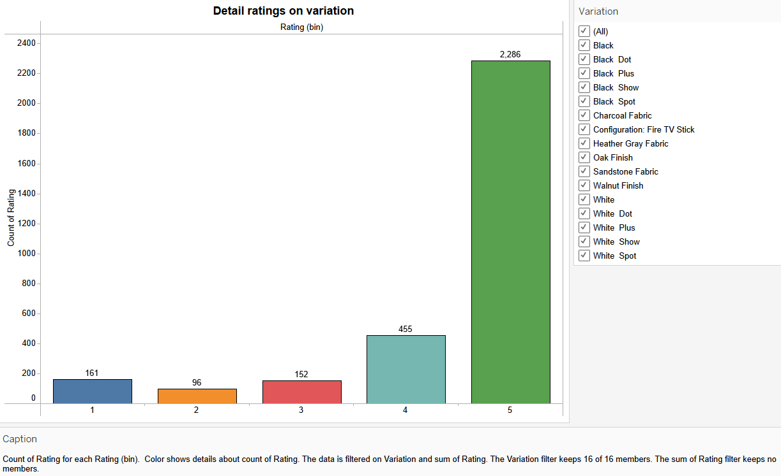
1)Variation versus Count of Rating- having colour variation on x-axis and Count of Rating on y-axis-We see that we have received 516 – highest rating for “Black Dot” color(most reviewed variant), 430 reviews for charcoal Fabric variation and only 9 reviews for “Walnut finish”(least reviewed variation). 2) Color_variation versus Count of Rating-Having variation of product colors_variation (x-axis) and Count of Rating(y-axis)-depicts Count of Rating for each Rating (bin). Color shows details about count of Rating. The data is filtered on Variation and sum of Rating. The Variation filter keeps 16 of 16 members. The sum of Rating filter keeps no members.

Slide 11
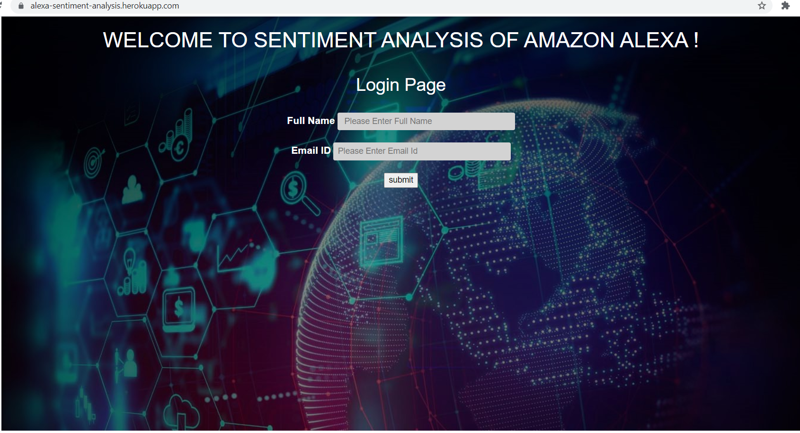
Deployment using Heroku-https://alexa-sentiment-analysis.herokuapp.com/

Slide 12
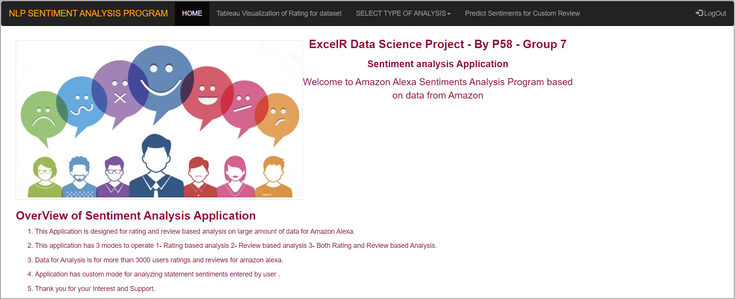
Deployment app overview

Slide 13
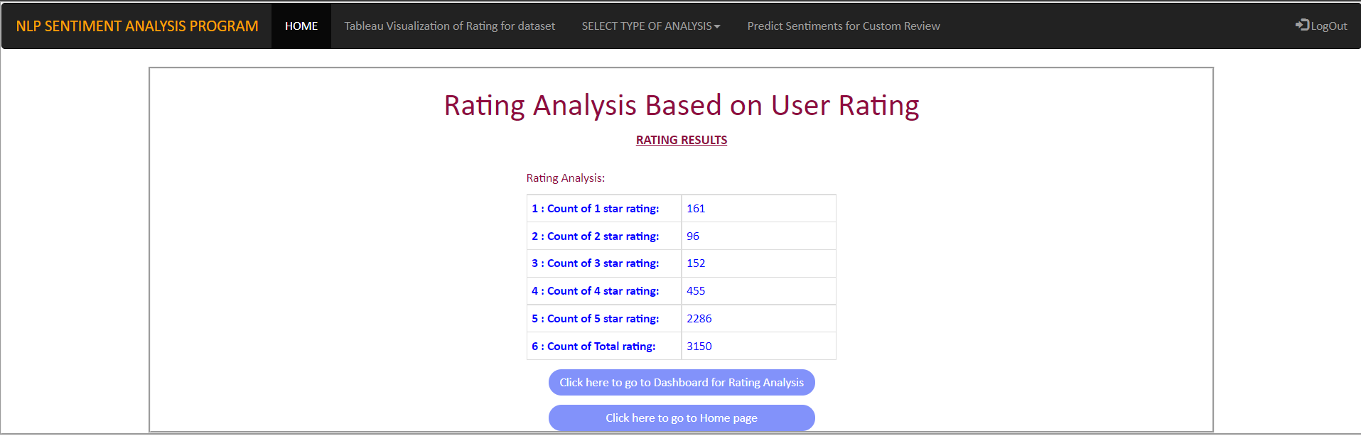
Rating based analysis

Slide 14
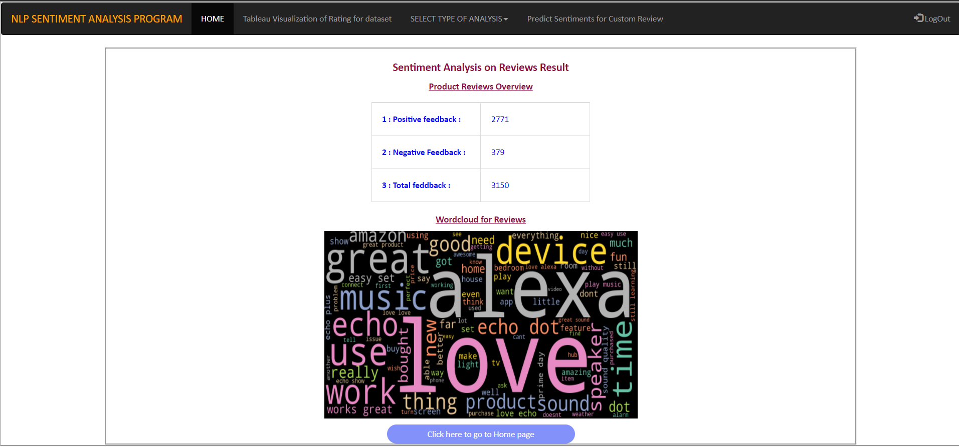
Review based Analysis

Slide 15
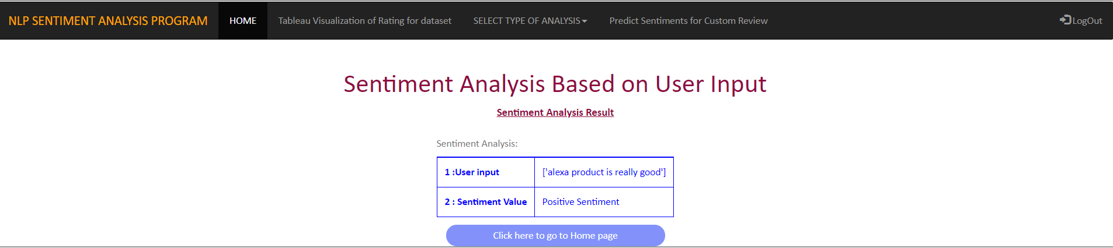
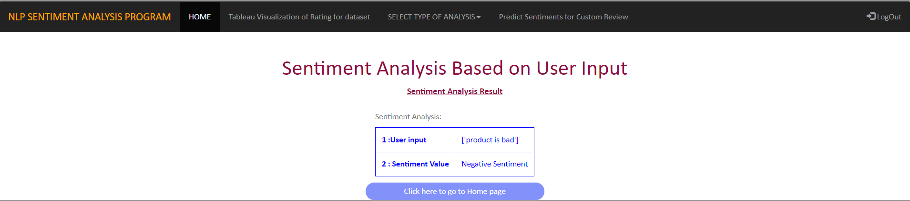
Predicting sentiments for custom review

Slide 16
Thank you

